Slide 1
APA Tutorial
A Guide to APA 7th Edition
Prepared by
Cheryl Kashuba, M.A., Writing Specialist
Marywood University Writing Center
2020

Slide 2
About This Tutorial
●The slides that follow highlight some of the basic elements of APA style.
● All information comes from the newest (7th) edition of the Publication Manual of the American Psychological Association.
● Section numbers and headings (for example, 8.17 Number of Authors to Include in In-text Citations) refer to specific sections of the APA manual.
● For further information beyond what is presented in this tutorial, please consult the relevant sections of the manual itself.

Slide 3
Table of Contents
**Brief overview of changes in the 7th edition: Slide 4
Part 1: The Title and the Title Page: Slides 5-10
(For a sample title page, see slide 6)
Part 2: Managing the Sources: Quoting and Paraphrasing: Slides 11-20
Part 3: Managing Your Sources: In-text Citations:
Discussion of citing sources: Slides 21-26
Citing a source with 1 author: Slide 27
Citing a source with 2 authors: Slide 28
Citing a source with 3 or more authors: Slide 29
Citing a source with no identified author: Slide 30
Groups as authors: Slide 31
Citing a source with no date: Slide 32
Citing a government report: Slide 33
Citing a personal communication: Slides 34-35
Including page numbers: Slide 36
Secondary sources: Using “as cited in”: Slides 37-38
Part 4: Managing the Sources: Reference List:
About the reference list: Slide 39
Sample reference list: Slide 40
Hanging indents: Slides 41-42
Alphabetizing reference list: Slides 43-45
How to format the author’s name and date of publication: Slides 46-48
Group authors: Slides 49-51
Title of an article in a scholarly journal: Slide 52
Title of a scholarly journal: Slide 53
Volume, issue, and page numbers of a journal: Slide 54
Digital object identifier (doi): Slides 55-56
No publication date: Slide 57
Books: Slides 58-61
Websites: Slides 62-65
Government reports: Slide 66
PowerPoint slides from a course: Slide 67

Slide 4
What’s changed in the 7th edition?
The 7th edition of the APA manual identifies a number of changes from the 6th edition, including the following:
Changes to the title page (see slides 5-9):
● A running head is no longer required for student papers; therefore, no running head appears on the title page.
● The course number and name are now included on the title page.
● The paper’s due date is now included on the title page.
● The instructor’s name is now included on the title page.
Additional Changes:
● A running head is no longer required for student papers.
● All in-text citations for sources with 3 or more authors, including the first citation, now use the name of the first author only, followed by the abbreviation et al. (see slide 29).
● The words “Retrieved from” are now included on the reference page only for websites with information that is designed to change over time without being archived. A retrieval date is also included (see slide 65).

Slide 5
Part 1: The Title Page:
What should the title page include?
For papers assigned by a professor for a class, the title page should include these elements:
● Page number inserted in top right-hand corner
● Paper’s title
● Author’s byline (i.e., your name)
● Author’s affiliation: department for which you are writing the paper, and the university
● Course number and name
● Instructor’s name
● Due date of the paper
* NOTE: See slide 6 for a sample title page. See slide 7 for formatting instructions.

Slide 6

Sample Title Page
*See the next slide for a title page that includes detailed instructions.

Slide 7
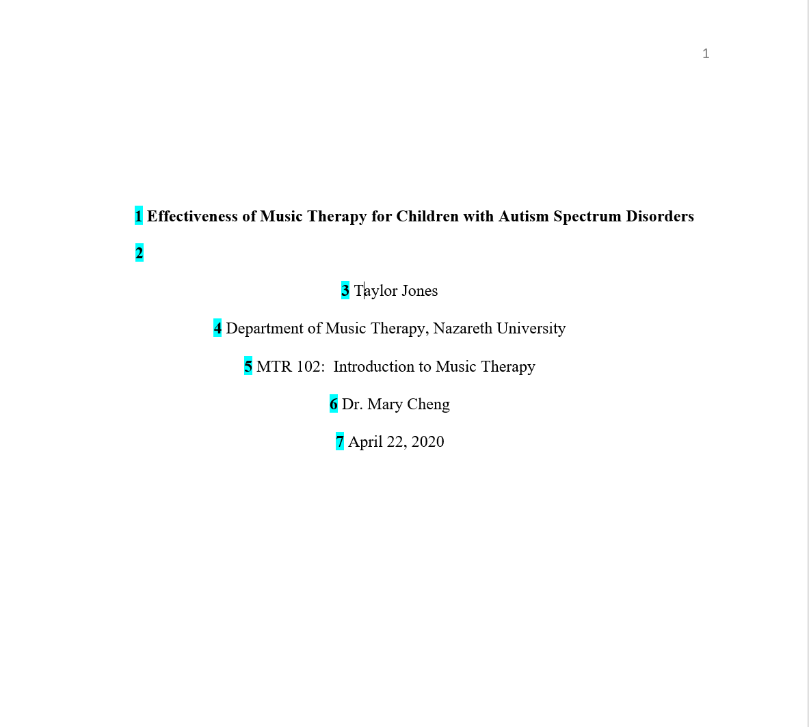
Formatting the title page
Page number:
Insert page numbers in the top right-hand corner.
1. Title:
Place the title three to four lines down from the top of the title page.
Center it and type it in bold font.
Capitalize major words of the title.
2. Space:
Add one double space between the title and your name.
3. Author’s name:
Center your name on its own line.
For two authors, use the word “and” between authors.
For three or more authors, place a comma between names; use “and” before the final author’s name.
4. Author’s affiliation:
Include the name of the department of the course for which you’re writing the paper.
Follow the department name by a comma and the name of the university.
5. Course:
Provide the course number as shown on your syllabus, followed by a colon and the course name.
6. Instructor’s name:
Provide the name of the instructor for the course using the format shown on your syllabus.
7. Due date:
Include the due date of the paper.
The numbers highlighted on the title page below correspond to the numbered list to the right.

Slide 8
Do I need a running head?
The APA manual section 1.7 Title states:
“Although a running head is not required of student papers in APA Style, some instructors or institutions may request it.”
If you are not sure if you need a running head, ask your professor.

Slide 9
How do I choose a title for my paper?
The APA manual section 1.7 Title states:
“The title should summarize the main idea of your paper simply and, if possible, in a way that is engaging for readers. For research papers, it should be a concise statement of the main topic of the research and identify the variables or theoretical issues under investigation and the relationship between them.”
Example of an appropriate title:
Effectiveness of Music Therapy for Children with Autism Spectrum Disorders

Slide 10
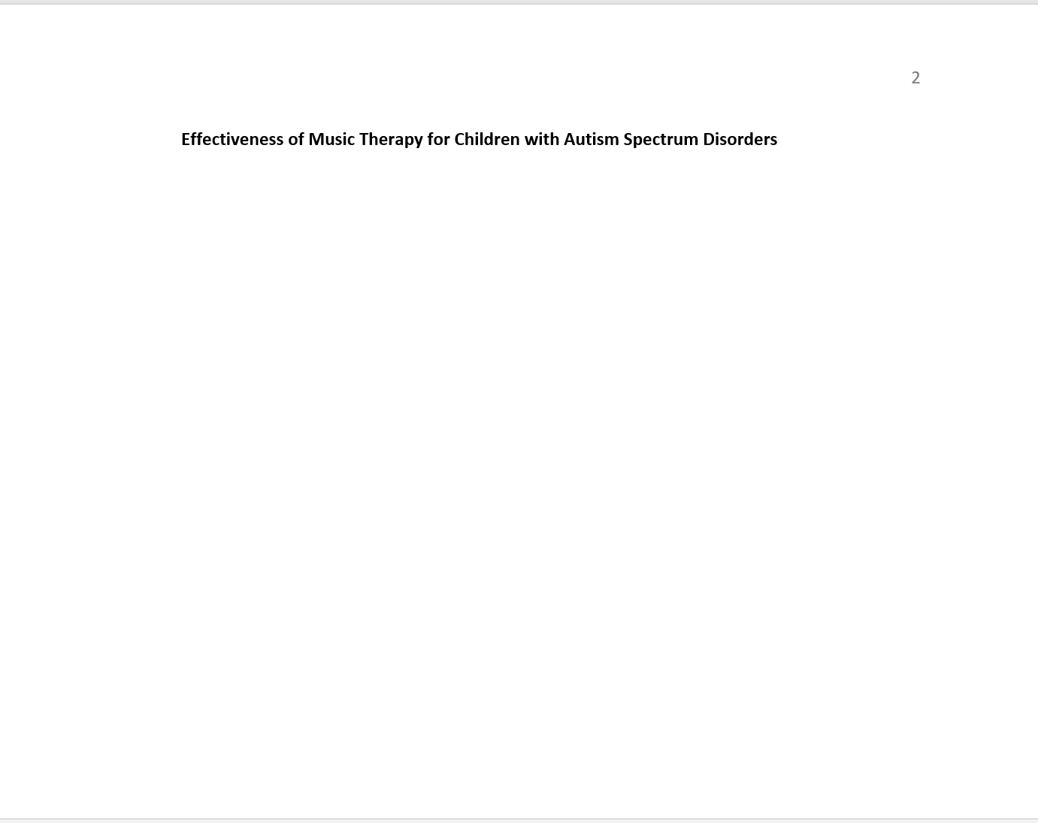
Do I need to repeat the title?
The APA manual section 1.11 Text (Body) states: “On the first line of the first page of the text, write the title of the paper again in title case…, bold, and centered.”
Your title at the top of the first page of your paper should look like this:
● Notice that the title is centered and bold face.
● Also notice that the page number appears in the upper right hand corner of the page.
● The page is numbered 2 because the title page is page number 1 of your paper.

Slide 11
Part 2: Managing Your Sources: Quoting and Paraphrasing
There are 3 ways to incorporate material from a source into your paper:
● Direct quote
● Paraphrase
● Combination paraphrase and quote
*The following slides provide rules and guidelines for each of these 3 methods.

Slide 12
Direct quote
Parenthetical citation: If you do not name the author in the text of your paper, the in-text citation should look like this:
“Musical improvisation is also commonly used to help with communication. Some children with ASD are nonverbal, so it is important to find ways for them to communicate nonverbally” (Crane, 2016, p. 116).
● Note that the citation comes after the quotation marks.
● Also note that the citation contains the name of the author, followed by a comma, followed by the date of publication.
● Note that a page number is included when citing a direct quote. Pay attention to the formatting of the page number.
● Note that the period comes after the citation.
*Also see next slide.

Slide 13
Direct quote continued
Narrative citation: If you do name the author in the text of your paper, the in-text citation should look like this:
Crane (2016) states, “musical improvisation is also commonly used to help with communication. Some children with ASD are nonverbal, so it is important to find ways for them to communicate nonverbally” (p. 116).
● Note that the date appears in parentheses immediately after the author’s name.
● Note that the page number is included in parentheses immediately after the quote.
● Note that the period at the end of the sentence comes after the final parenthesis that contains the page number.

Slide 14
Direct quote that is 40 or more words
Use long quotations sparingly. For quotations of 40 or more words:
● Start a block quotation on a new line
● Indent the block quotation 0.5 inches from the left margin
● Double space the entire block quotation
● Do not use quotation marks around the block quotation
● You can cite the source in parentheses after the quotation’s final punctuation. OR you can cite the author and year in the narrative before the quotation and place only the page number in parentheses after the quotation’s final punctuation.
● In either case, do not add a period after the closing parenthesis.
*See the next slide for an example of a blocked quote.

Slide 15
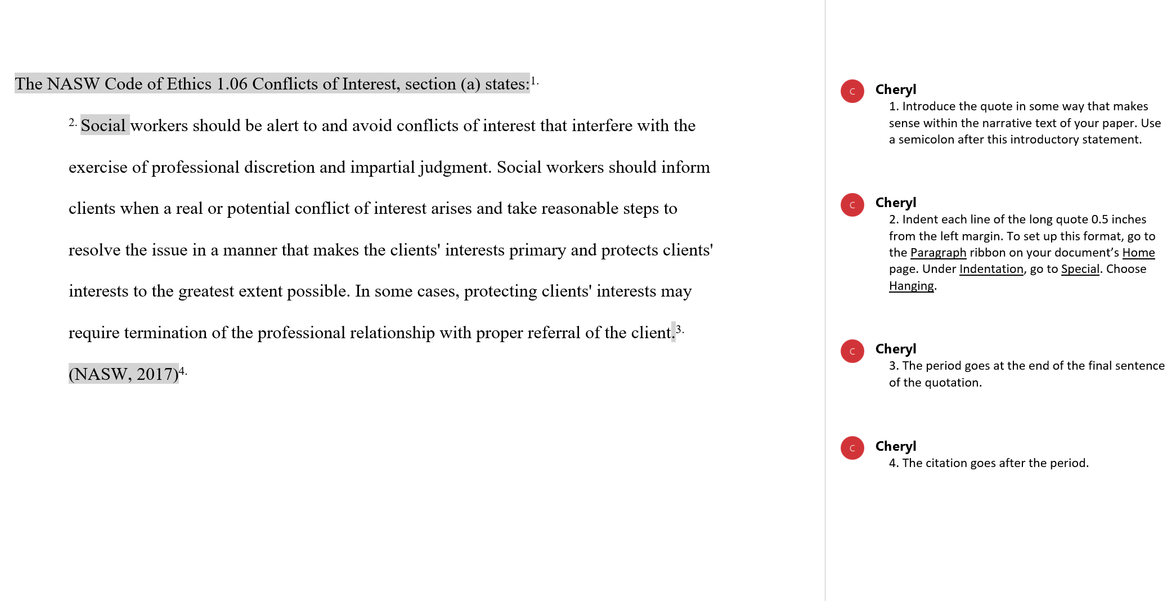
Example of a direct quote that is 40 or more words
The numbered comments provide instructions for formatting long quotations.
Note: The citation for this direct quote does not contain page numbers because the source is a website, and there are no page numbers on the website.

Slide 16
Paraphrase
Most of the time, you will want to paraphrase the information you take from sources. But what does it mean to paraphrase?
● To paraphrase, change the wording found in the source into your own words
● Also change the structure of the sentence
● According to APA, you do not have to provide a page number in the citation when you paraphrase. You can include page numbers for longer works, such as books, so that your reader can find the information in the source if they wish to.
*See the next 2 slides for further information and examples.

Slide 17
A problematic paraphrase
● A problematic paraphrase keeps the sentence structure of the original and simply changes a few words.
Here is an original passage from a journal article:
“Musical improvisation is also commonly used to help with communication. Some children with ASD are nonverbal, so it is important to find ways for them to communicate nonverbally” (Crane, 2016, p. 116).
Here is an example of a problematic paraphrase:
Musical improvisation is also frequently used to assist communication. Some children with ASD are nonverbal, so the therapist needs to find ways for them to communicate nonverbally (Crane, 2016, p.116).
● NOTE: This paraphrase is problematic because, technically, it is plagiarism!!! That is true even though the source is cited. Why? Because the basic sentence structure is maintained, with only a few words changed.
* See the next slide for an example of an acceptable paraphrase.

Slide 18
An acceptable paraphrase
● An acceptable paraphrase keeps the meaning but changes both the wording and the sentence structure of the original.
● NOTE: You must cite the source when you paraphrase.
Here is an original passage from a journal article:
“Musical improvisation is also commonly used to help with communication. Some children with ASD are nonverbal, so it is important to find ways for them to communicate nonverbally” (Crane, 2016, p. 116).
Here is an example of an acceptable paraphrase:
Musical improvisation can be an effective way to help nonverbal children with ASD to communicate (Crane, 2016).

Slide 19
Combination paraphrase and direct quote
Another option to using a direct quote is to use a combination of a paraphrase and a direct quote. Be sure to include page numbers when quoting, if the source you are using contains page numbers.
The original passage from the journal article:
“Musical improvisation is also commonly used to help with communication. Some children with ASD are nonverbal, so it is important to find ways for them to communicate nonverbally” (Crane, 2016, p. 116).
Direct quote with a paraphrase:
Crane (2016) states that “some children with ASD are nonverbal, so it is important to find ways for them to communicate nonverbally,” and musical improvisation is one method that can be used (p. 116).
*Note that the letter s in the word some was changed to a lower case letter because of its placement in the middle of the sentence. The APA manual 8.30 Changes to a Quotation Requiring No Explanation states that this change is permitted.

Slide 20
How to use a quote within a quote
The source that you are reading may quote someone directly, putting their words in quotation marks. If you want to use that direct quote in your paper, then you would be quoting already quoted words. How do you format this quote within a quote?
In the example below, the source is a report by the United States Department of Justice. That report quotes the words of Thomas E. Perez, Assistant Attorney General for the Civil Rights Division of the United States Department of Justice.
● The format for a quote within a quote is to use single quotation marks within double quotation marks.
Single quotation marks look like this: ‘quote’
Double quotation marks look like this: “quote“
Put them together like this: “’quote‘”
Example:
Federally-funded schools are required to provide each child, regardless of ability, with equal access to the school and to any activities or programs that it offers. “’All children deserve access to educational services, and making sure that schools are fully accessible to children with disabilities is a necessary part of integrating individuals with disabilities into all aspects of American life,’” according to Thomas E. Perez, Assistant Attorney General for the Civil Rights Division (United States Department of Justice, 2011).
Note: The citation for this direct quote does not contain page numbers because the sources is a website, and there are no page numbers on the website.

Slide 21
Part 3: Managing the Sources: In-text citations
What are in-text citations?
● In-text citations are a method of acknowledging that you have taken information or ideas from a source - i.e., a journal article, book, website, or some other source
● They include the author(s) and date of publication of the work you are citing
● For quoted material, they also include the page number
  *NOTE: The slides that follow provide specific rules and examples for citing various sources using in-text citations.

Slide 22
What sources should I cite?
The Rule:
According to the APA manual section 8.1 Appropriate Level of Citation:
“Cite the work of those individuals whose ideas, theories, or research have directly influenced your work. The works you cite provide key background information, support or dispute your thesis, or offer critical definitions and data. Cite only works that you have read and ideas that you have incorporated into your writing.”
*See the next slide.

Slide 23
So what does the rule mean, exactly?
*See previous slide
You must include a citation for any information or ideas that you take from a source, whether you quote directly or not.
This includes:
  ● Facts, including:
      Background information
      Statistics
  ● Ideas
  ● Theories
  ● Research
  ● Anything else that you take from a source

Slide 24
How should I cite my sources?
Cite your sources using what the APA calls the author-date citation system.
The APA manual section 8.10 Author-Date Citation System says: “In this system, each work used in a paper has two parts: an in-text citation and a corresponding reference list entry.”
These two parts work together:
●The in-text citation identifies, for your reader, the source from which you got the information, ideas, or other material that you have included in a specific part of your paper.
●The in-text citation corresponds to a source listed on your reference list.
The reference list is the part of the paper where you list the sources you used for the paper, and provide all of the publication information for each source.
The reference list identifies each of the sources that you used so that your reader can locate those sources should they wish to access them.

Slide 25
Important things to remember about in-text citations
● In-text citations acknowledge that you have taken information or ideas from a source (i.e., a journal article, book, website, or some other source)
● You must include a citation for any information or ideas that you take from a source, whether you quote directly or not
● The in-text citation is included with the information that you have taken from the source
● For the in-text citation, include the author(s) and the date of publication
● Citations for quoted material also include page numbers. Citations for paraphrased material may contain page numbers (see slide 16)
● APA calls for different forms depending on the number of authors of a given source
*The following slides cover basic how-to do instructions for in-text citations.

Slide 26
What form should I use for my in-text citations?
There are 2 forms of in-text citations:
● The parenthetical citation, where the author(s) and date appear in parentheses
● The narrative citation, where name(s) of the author(s) appear in the text of your paper, and the date appears in parentheses next to the author(s)’s name(s)
*The following slides provide rules and examples for in-text citations.

Slide 27
Citing a source with 1 author
The Rule:
According to the APA manual section 8.17 Number of Authors to Include in In-text Citations:
“For a work with one or two authors, include the author name(s) in every citation.”
Citing the source:
Parenthetical citation: If you do not name the author in the text of your paper, the in-text citation should look like this:
Access to health care is a significant concern among Latinos. Participants in one study said that they delayed seeking medical care “until their pain was unbearable.” Among those who went to a doctor, some reported that just one visit cost as much as a week’s salary. Participants in this study expressed the need for an affordable, comprehensive health insurance that would cover all of their medical needs, including regular doctor visits (Ayon, 2014, p. 17).
Narrative citation: If you do name the author in the text of your paper, the in-text citation should look like this:
      Ayon (2014) found that access to health care is a significant concern among Latinos. Participants in one study said that they delayed seeking medical care “until their pain was unbearable.” Among those who went to a doctor, some reported that just one visit cost as much as a week’s salary. Participants in this study expressed the need for an affordable, comprehensive health insurance that would cover all of their medical needs, including regular doctor visits (p. 17).

Slide 28
Citing a source with 2 authors
The Rule:
    According to the APA manual section 8.17 Number of Authors to Include in In-text Citations:
    “For a work with one or two authors, include the author name(s) in every citation.”
Citing the source:
Parenthetical citation: If you do not name the author in the text of your paper, the in-text citation should look like this:
      Black children are overrepresented in the child welfare system because they are referred more than white children. One way to address this benevolent oppression is to include bias training for social workers who provide direct services to children (Kelly & Varghes, 2018).
Narrative citation: If you do name the author in the text of your paper, the in-text citation should look like this:
      Kelly and Varghes (2018) argue that one way to address the benevolent oppression of Black children in the child welfare system is to include bias training for social workers who provide direct services to children.

Slide 29
Citing a source with 3 or more authors
The Rule:
According to the APA manual section 8.17 Number of Authors to Include in In-text Citations:
“For a work with three or more authors, include the name of only the first author plus ‘et al.’ in every citation, including the first citation, unless doing so would create ambiguity.”
Citing the source:
Parenthetical citation: If you do not name the author in the text of your paper, the in-text citation should look like this:
Research suggests that poor emotion regulation skills can impede successful social interactions, a finding that has implications for children with ASD (Berkovits et al., 2017).
Narrative citation: If you do name the author in the text of your paper, the in-text citation should look like this:
Berkovits et al. (2017) found that poor emotion regulation skills can impede successful social interactions, a finding that has implications for children with ASD.

Slide 30
Citing a source with no identified author
The Rule:
According to the APA manual section 8.14 An Unknown or Anonymous Author:
● Use the title and publication year in your in-text citation.
● If the title is italicized in the references list, then italicize it in the in-text citation.
● If it’s not italicized in the references list, then put it in double quotation marks in the in-text citation.
Example:
Jordan Frye, who received her MSSW in 2016, emphasized the importance of flexibility during the pandemic. Ms. Frye normally works in community development, but she has had to re-focus to help meet immediate needs of food and other basic necessities. She calls this practice “holding the line,” which, she says, is “a kind of assertiveness which is basic to social work…I’ve had to do it every week when reminding people about effectively implementing safety protocols. It can be hard to hold the line, but I think of it as an act of compassion” (“Social work alumni redefine essential care during pandemic,” 2020).
*Note: If the title is long, you may shorten it in your in-text citation, like this: (“Social work alumni,” 2020).
* Note: The citation for this direct quote does not contain page numbers because the source is a website, and there are no page numbers on the website.

Slide 31
Groups as authors
If an agency or other group is responsible for writing the material from the source, then that agency or group serves as the author, and that agency or group is called a group author. This situation is common on websites. In the example below, the National Association of Social Workers is the agency that has authored the source.
Citing the source:
Parenthetical citation: If you do not name the author in the text of your paper, the in-text citation should look like this:
Social workers have to recognize that they are in a position of “privilege and power” and must be aware of how their position may impact their work (National Association of Social Workers, 2015, p. 5).
Narrative citation: If you do name the author in the text of your paper, the in-text citation should look like this:
The National Association of Social Workers (2015) encourages social workers to recognize that they are in a position of “privilege and power” and to be aware of how their position might impact their work with clients (p. 5).

Slide 32
Citing a source with no date
The Rule:
According to the APA manual Table 9.1 How to Create a Reference When Information Is Missing:
Write “n.d.” for “no date.”
Citing the source:
Parenthetical citation: If you do not name the author in the text of your paper, the in-text citation should look like this:
Intervention should begin as soon as possible, and families or individuals should look into the available therapy options and choose the one that will work best for them. (Autism Society of America, n.d.)
Narrative citation: If you do name the author in the text of your paper, the in-text citation should look like this:
The Autism Society of America (n.d.) advises that intervention should begin as soon as possible, and families or individuals should look into the available therapy options and choose the one that will work best for them.

Slide 33
Citing a government report
Many types of government reports are available on government websites. If the report has no author, then use the government agency as the group author (see slide 31 for a discussion of groups as authors). In the examples below, the group author is the United States Department of Justice. Note: The citation for this direct quote does not contain page numbers because the source is a website, and there are no page numbers on the website.
Citing the source:
Parenthetical citation: If you do not name the author in the text of your paper, the in-text citation should look like this:
Federally-funded schools are required to provide each child, regardless of ability, with equal access to the school and to any activities or programs that it offers. “’All children deserve access to educational services, and making sure that schools are fully accessible to children with disabilities is a necessary part of integrating individuals with disabilities into all aspects of American life,’” according to Thomas E. Perez, Assistant Attorney General for the Civil Rights Division (United States Department of Justice, 2011).
Narrative citation: If you do name the author in the text of your paper, the in-text citation should look like this:
The United States Department of Justice (2011) determined that federally-funded schools are required to provide each child, regardless of ability, with equal access to the school and to any activities or programs that it offers. “’All children deserve access to educational services, and making sure that schools are fully accessible to children with disabilities is a necessary part of integrating individuals with disabilities into all aspects of American life,’” according to Thomas E. Perez, Assistant Attorney General for the Civil Rights Division.

Slide 34
Citing a personal communication
What is a personal communication?
The APA manual section 8.9 Personal Communications “identifies personal communications as ‘works that cannot be recovered by readers.’ That means that readers don’t have access to those works.”
Personal communications include the following:
● Interviews that you conduct with someone
● Emails, text messages, and telephone conversations
● Live speeches
● Unrecorded classroom lectures
● Memos and letters
● Messages from nonarchived discussion groups or online bulletin boards
*See the next slide for additional instructions.

Slide 35
Citing a personal communication, continued
● Cite personal communications in the text of your paper only
● Do not include personal communications in your reference list
For the intext citation:
● Provide the initial(s) of the person’s first name, or first and middle name
● Provide the person’s last name (surname)
● Provide the date on which the communication took place. If you are unsure of the exact date, the APA manual advises you to “provide as exact a date as possible” (section 8.9 Personal Communications).
Use the following formats:
Parenthetical citation: If you do not name the author in the text of your paper, the in-text citation should look like this:
(J. Gonzalez, personal communication, April 24, 2020)
Narrative citation: If you do name the author in the text of your paper, the in-text citation should look like this:
As J. Gonzalez noted in a recent telephone conversation, (personal communication, August 8, 2019)…

Slide 36
Including page numbers
If you are quoting a source that has page numbers, then you must include page numbers in your citation if the source has numbered pages. According to APA, you do not have to provide a page number in the citation when you paraphrase. When you paraphrase, you can include page numbers for longer works, such as books, so that your reader can find the information in the source if they wish to.
In the following examples, the author of the source is the National Association of Social Workers.
Citing the source:
Parenthetical citation: If you do not name the author in the text of your paper, the in-text citation should look like this:
Social workers have to recognize that they are in a position of “privilege and power” and must be aware of how their position may impact their work (National Association of Social Workers, 2015, p. 5).
Narrative citation: If you do name the author in the text of your paper, the in-text citation should look like this:
The National Association of Social Work (2015) encourages social workers to recognize that they are in a position of “privilege and power” and to be aware of how their position might impact their work with clients (p. 5).

Slide 37
Secondary sources: Using “as cited in”
Many of the sources that we use, such as journal articles, cite sources within them. The original source is called a primary source. The source that is citing that primary source is called a secondary source.
For example, say that you read a journal article by Berkovits et al. In their article, Berkovits et al. cite an article by Jahromi et al. The article by Jahromi et al. is the primary source. The article by Berkovits et al. is the secondary source. What do you do in this situation?
● The APA advises that you try to find the primary source (that is, the article by Jahromi et al.), read it yourself, and cite that source.
● But if you can’t find the primary source (the article by Jahromi et al.), then cite the secondary source (the article by Berkovits et al.) and use “as cited in.”
*See the next slide for an example.

Slide 38
Secondary sources: Using “as cited in,” continued
The previous slide discusses using secondary sources. If you need to cite a source that is cited in another source, here’s how to do it.
Parenthetical citation: If you do not name the author in the text of your paper, the in-text citation should look like this:
When comparing children with ASD aged 3-7 with their typically developing peers, children with ASD “exhibited less advanced emotion regulation when frustrated” (Jahromi et al., 2012, as cited in Berkovits et al., 2017, p. 69).
Narrative citation: If you do name the author in the text of your paper, the in-text citation should look like this:
When comparing children with ASD aged 3-7 with their typically developing peers, Jahromi et al. (2012) found that children with ASD “exhibited less advanced emotion regulation when frustrated” (as cited in Berkovits et al., 2017, p. 69).
*NOTE: Cite Berkovits et al. in the reference list. Do not cite Jahromi et al. in the reference list.

Slide 39
Part 4: Managing Your Sources: Reference list
What is the reference list?
The reference list is a list of the sources you have cited throughout your paper.
The reference list appears on a separate page at the end of your paper.
The heading References appears at the top of the page, centered and bold face. Capitalize the R in References.
Each item on your reference list should, generally, contain the following:
  ● Author(s)’s name(s)
  ● Date of publication
  ● Title of the work
  ● Relevant publication information
  *The following slides show you in detail how to set up your reference list and how to format sources listed there.

Slide 40
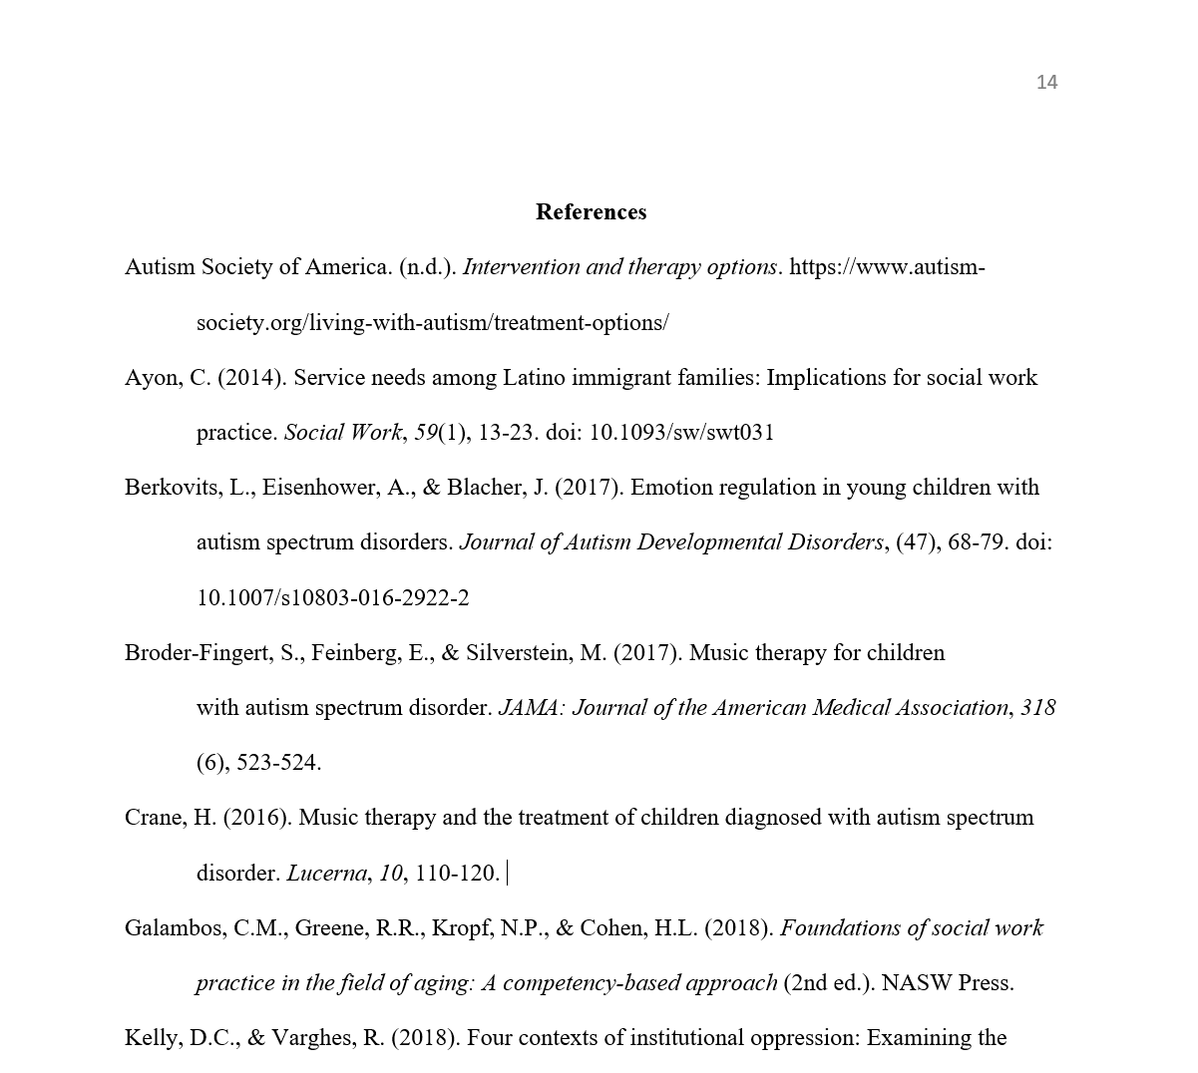
Sample reference list

Slide 41
About hanging indents
Look at the sample reference list in the previous slide.
● The reference list is a list of entries. Each entry is a source that you cited in your paper.
● Notice that the first line of each entry is flush with the paper’s left margin.
● Notice that the other lines of each entry are indented.
● This indentation is called a hanging indent.
*The next slide shows you how to format a hanging indent.

Slide 42
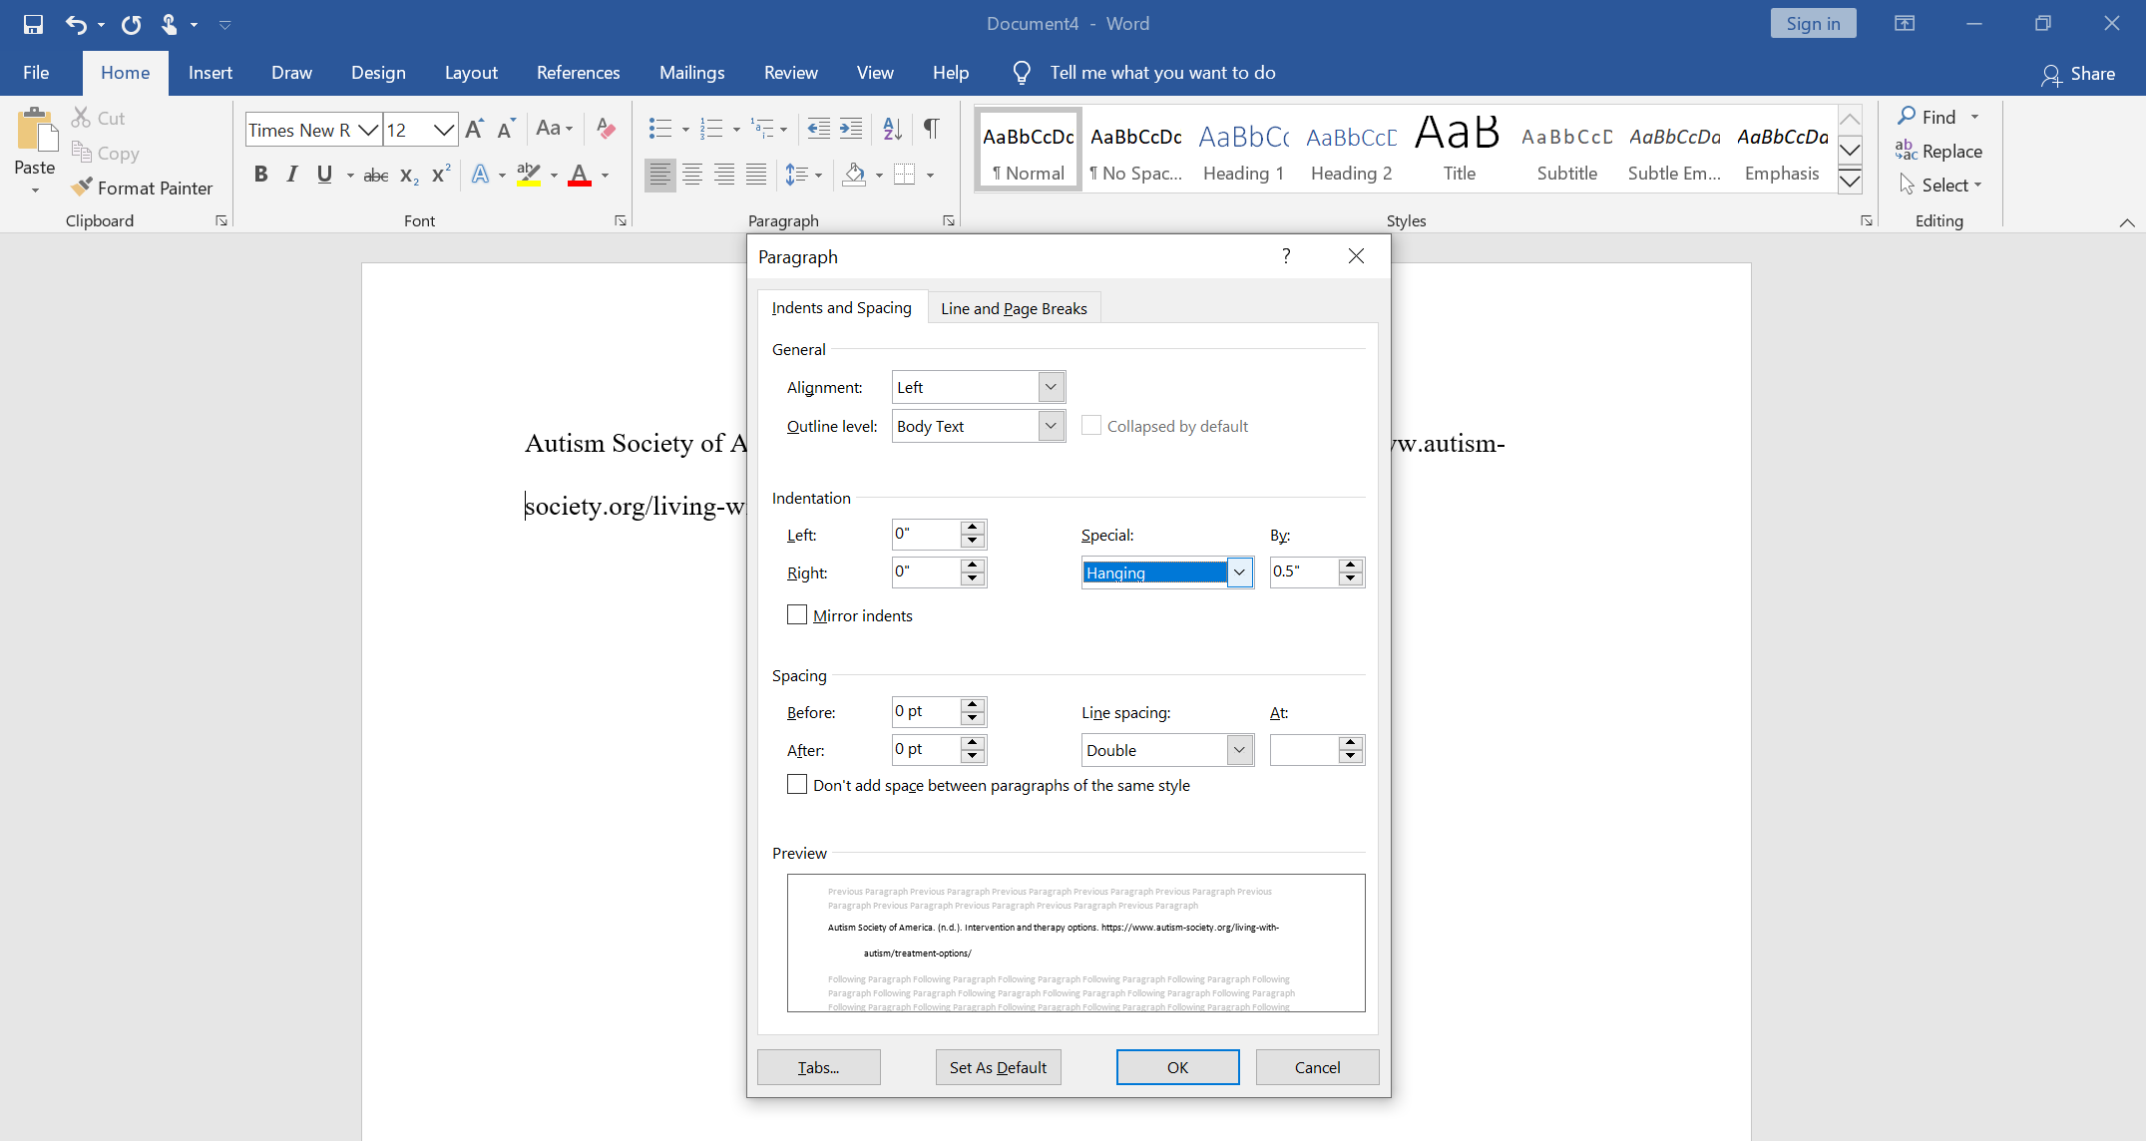
How to format a hanging indent
● Put your cursor on the line that you want to indent
● Go to the Paragraph section of your Home page
● Click to open the menu
● Under Indentation, find Special
● Open the drop-down menu and choose Hanging

Slide 43
Alphabetize your reference list
Alphabetize the entries on your reference list according to the last name of the first author.

Slide 44
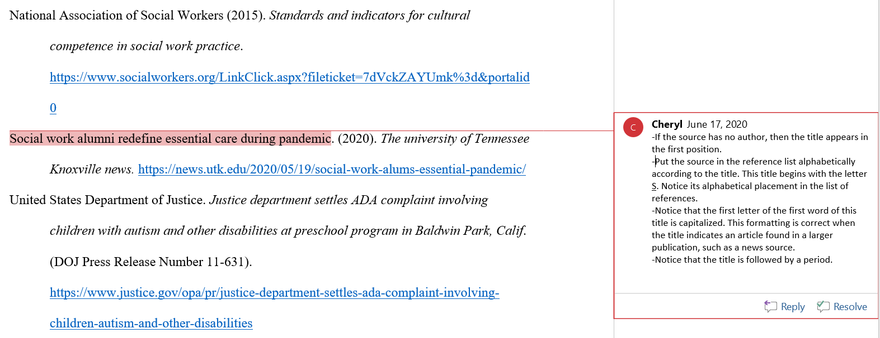
Alphabetizing if a source has no author
*Note: For this slide and the slides that follow, the instructions are included in the comments inserted on the pages.

Slide 45
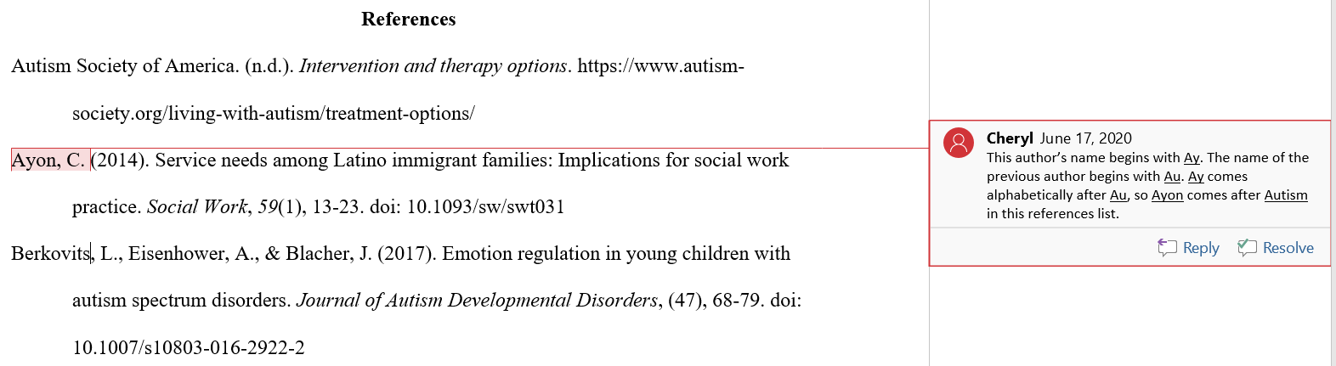
Alphabetizing when 2 sources begin with the same letter

Slide 46
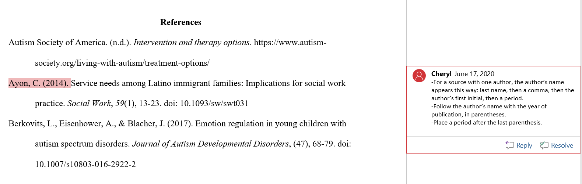
How to format the author’s name and the date of publication if the source has only one author

Slide 47
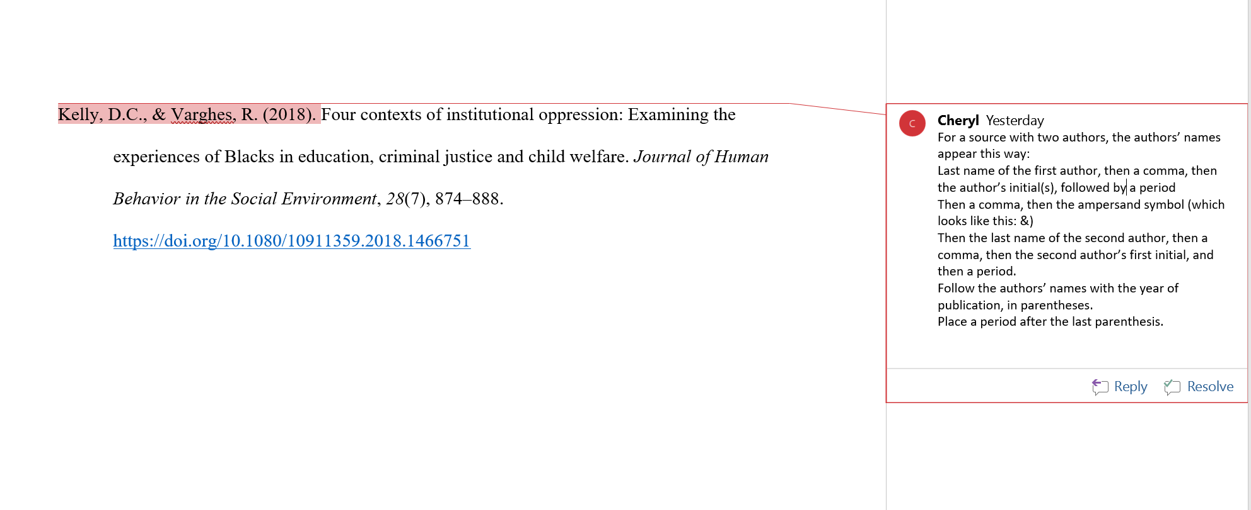
How to format the authors’ names and the date of publication if the source has two authors

Slide 48
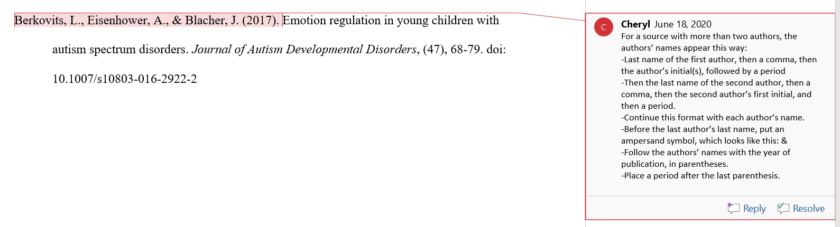
How to format the authors’ names and the date of publication if the source has more than two authors

Slide 49
Group authors
What is a group author?
Nonprofit organizations and government agencies often act as the authors of material that they make available to the public. That information may appear on the organization’s or agency’s website. Or it may appear in pamphlets, books, or other publications.
How do I know if my source was written by a group author?
Check the source to see if any individual authors are listed anywhere. If you don’t see individual authors’ names, then treat the organization or agency as a group author.
*See the next slide for an example of a source with a group author.

Slide 50
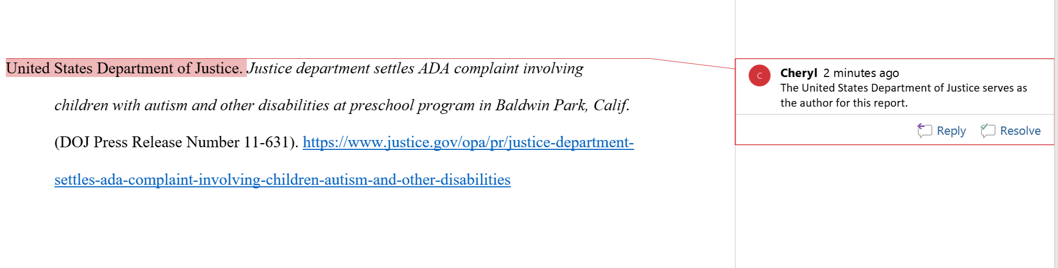
Group authors, continued
*See the next slide for additional instructions.

Slide 51
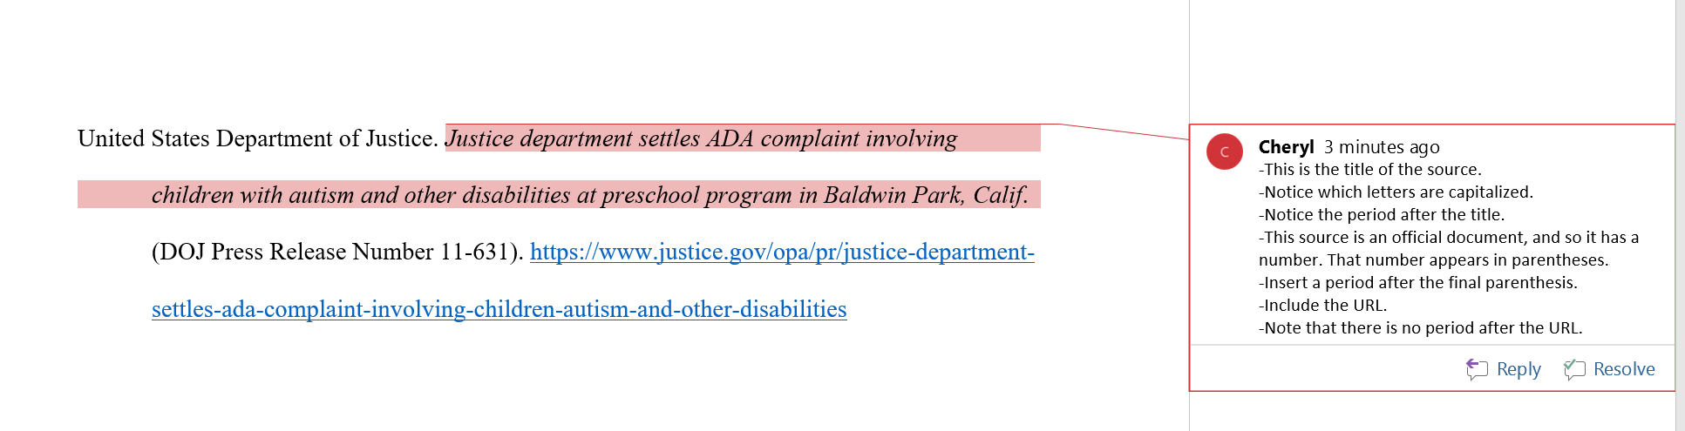
Groups as authors, continued:
Additional information to include

Slide 52
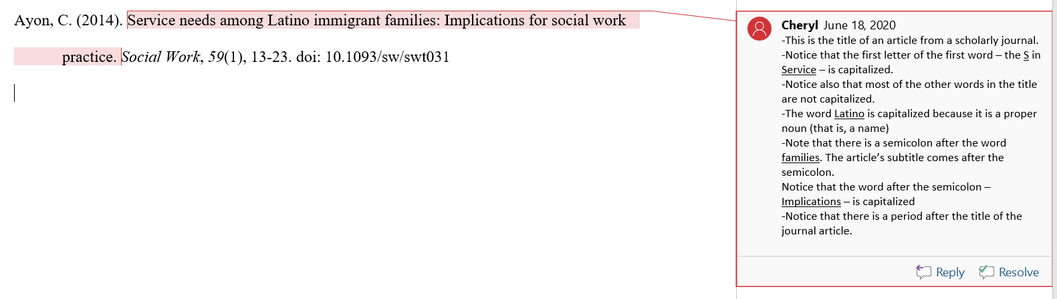
How to format the title of an article in a scholarly journal

Slide 53
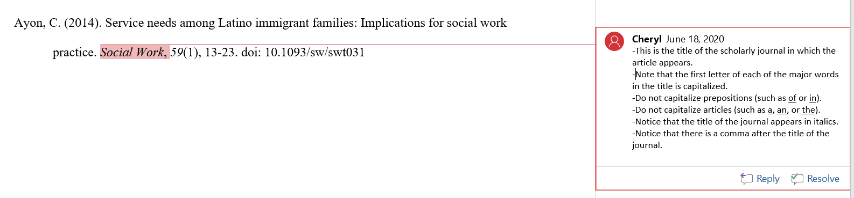
How to format the title of a scholarly journal

Slide 54
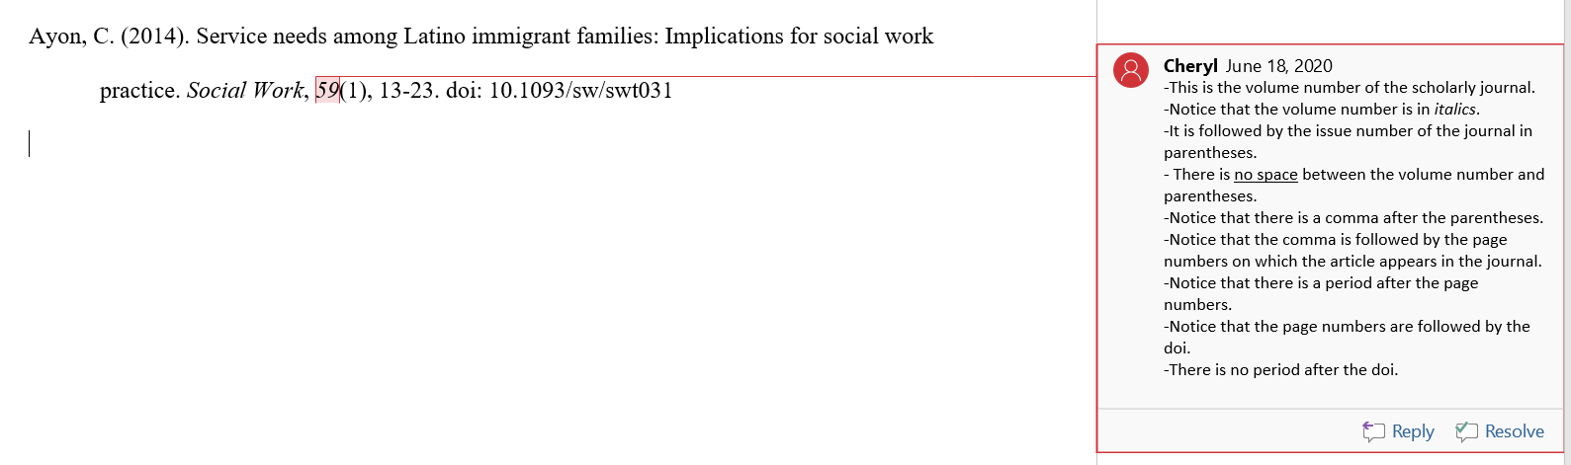
How to format the volume, issue, and page numbers of a journal

Slide 55
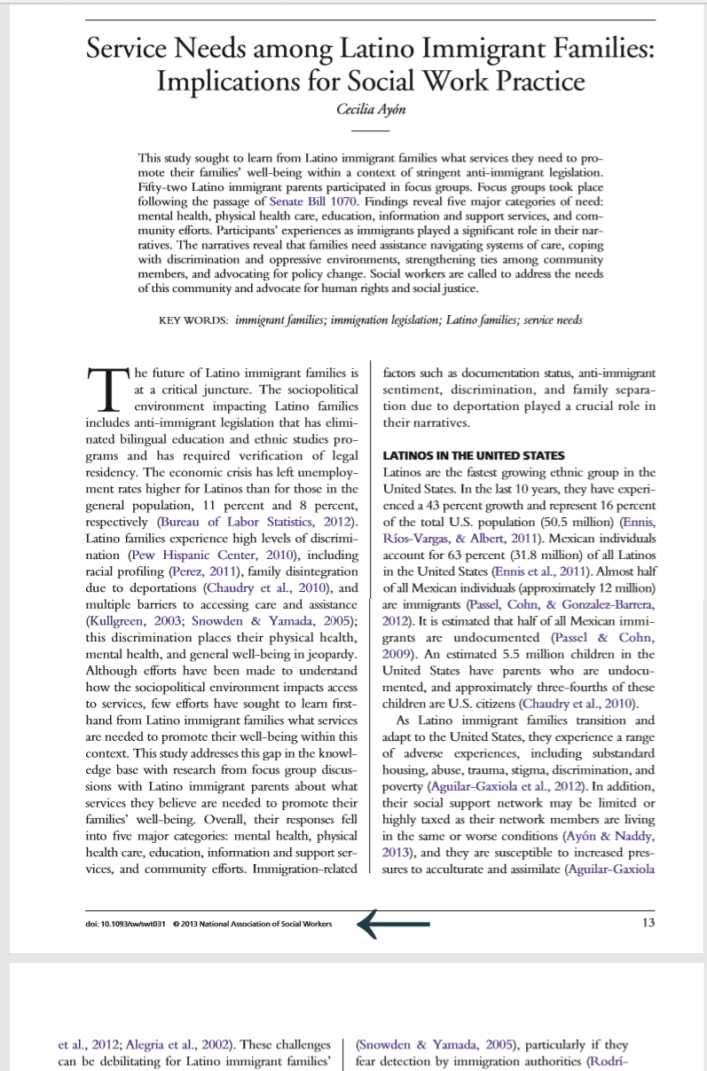
The digital object identifier (doi)
What is a doi?
The letters doi stand for Digital Object Identifier. Many articles from online databases have a doi.
Where do I find the doi?
The doi often appears at the bottom of the article’s pages, as indicated by the arrow in the photo image shown at the right.
*See the next slide for instructions on how to include the doi in your reference list.

Slide 56
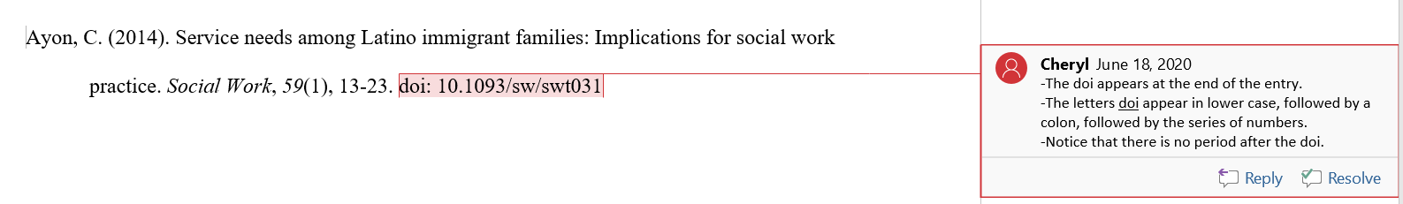
How to include the doi in your reference entry

Slide 57
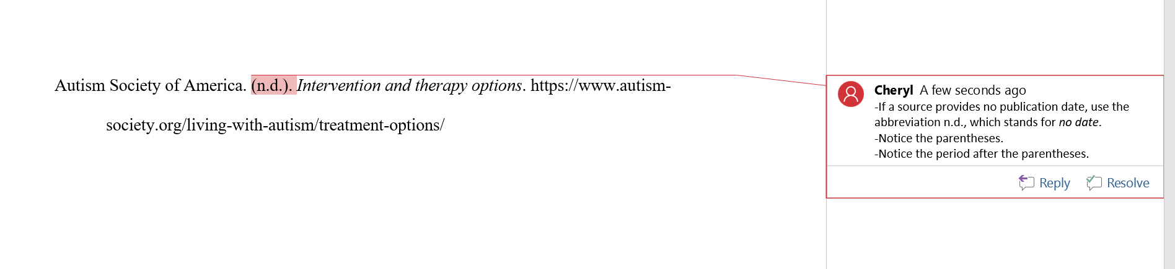
When a source provides no publication date

Slide 58
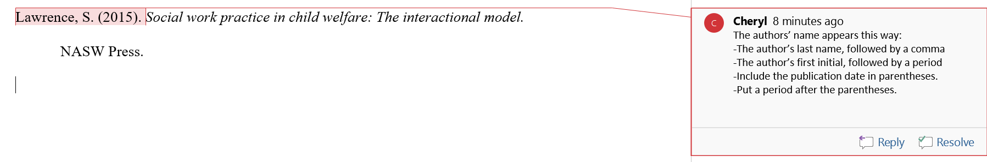
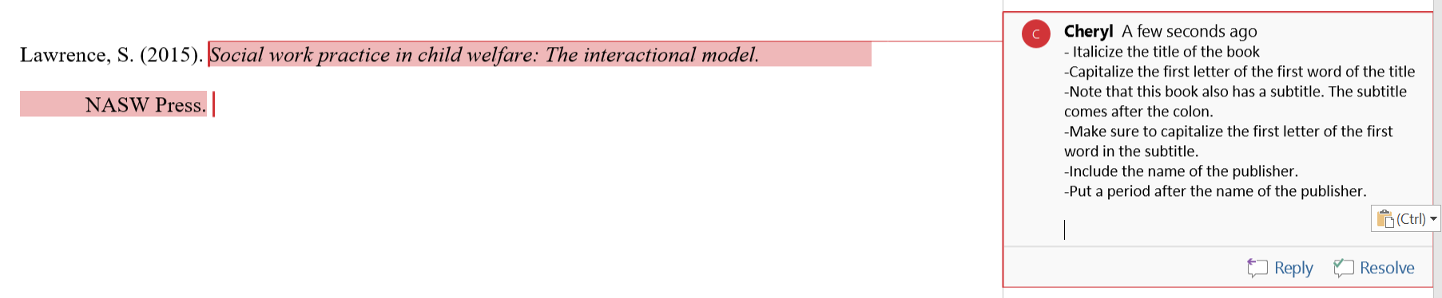
How to format the entry for a book
The author and date:
The publication information:

Slide 59
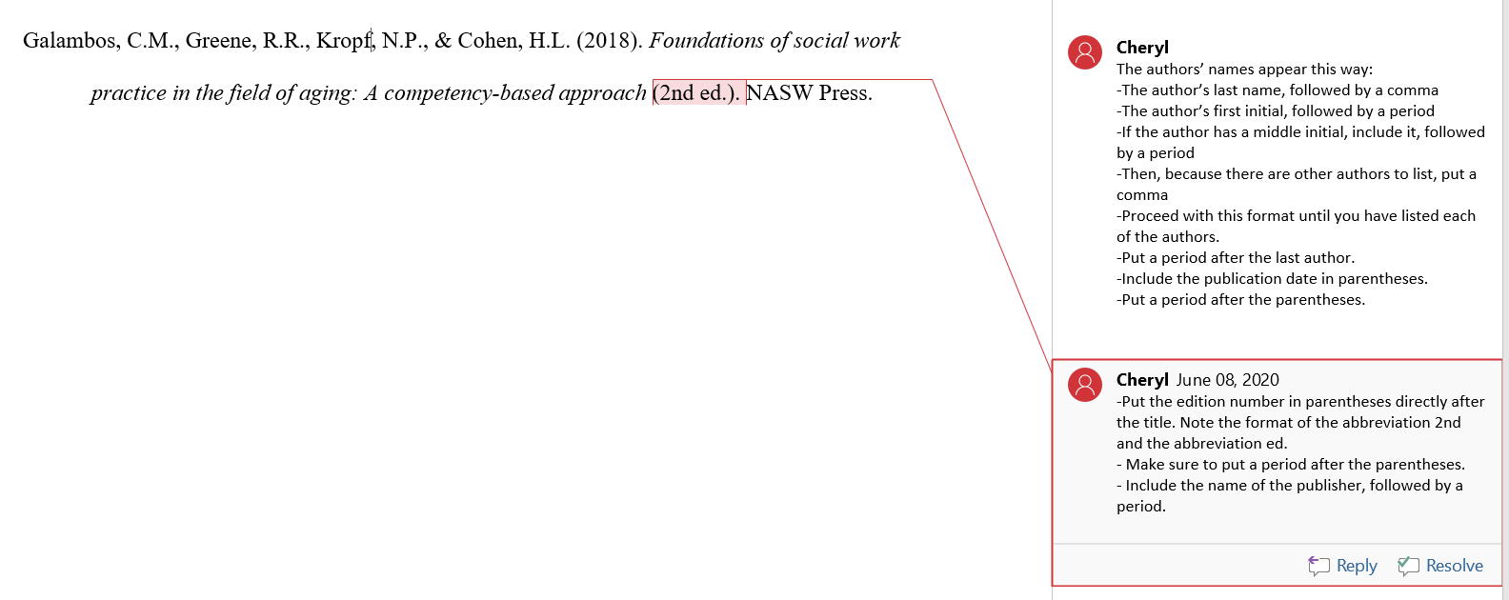
How to format the entry for a book with an edition

Slide 60
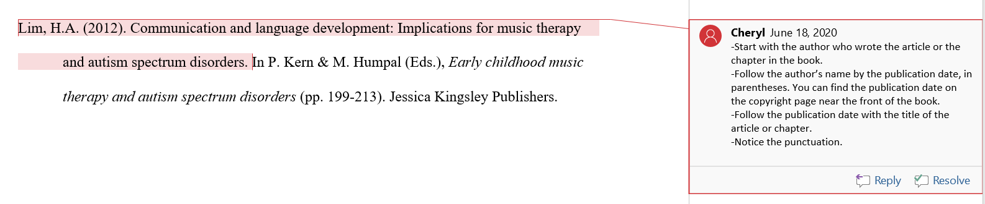
How to format an article or chapter from a book with an editor
* See the next slide for additional instructions.

Slide 61
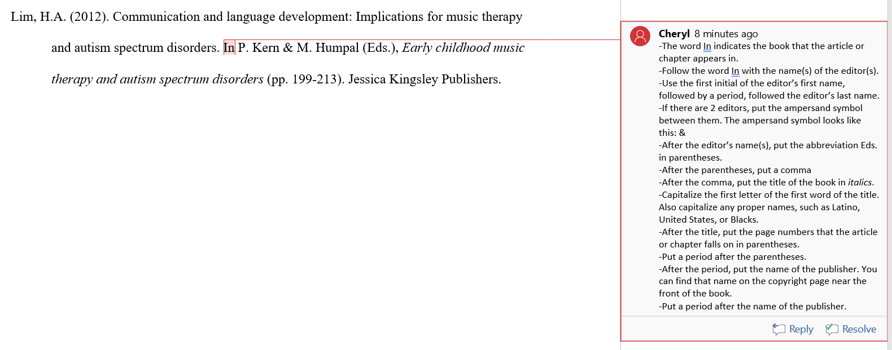
How to format an article or chapter from a book with an editor, continued

Slide 62
How to format the entry for a website
● If the page on the website has an author or authors, then use their name(s).
● For a page from an organization’s website without individual authors, use the name of the organization as the author.
● Include a specific date if the webpage provides one. Otherwise, use n.d. for no date.
● Italicize the title of the webpage. Capitalize the first letter of the first word of the title. Use lower case letters for articles (a, an, the) and for prepositions (such as: to, from, about). Capitalize any proper nouns (such as African American, United States, Mexican).
● For a page from an organization’s website, the author of the webpage and the site name are the same. For this reason, omit the site name from the source element to avoid repetition.
● Use the words “Retrieved from” when contents of a webpage are designed to change over time but are not archived. Also include a retrieval date in the reference.
● End the reference with the URL. Do not put a period after the URL.
*See the next 3 slides for examples with detailed instructions.

Slide 63
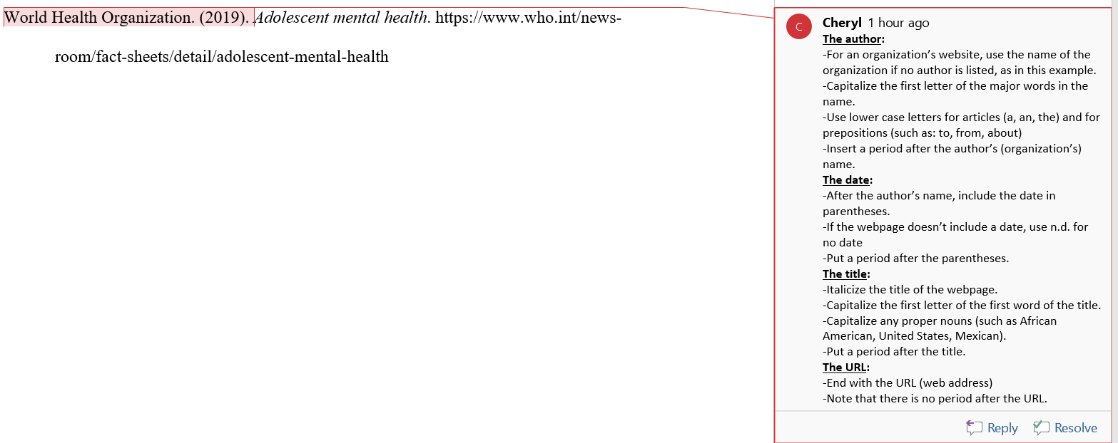
Example of the format for a webpage with a group author
See slide 31 for a discussion of groups as authors.

Slide 64
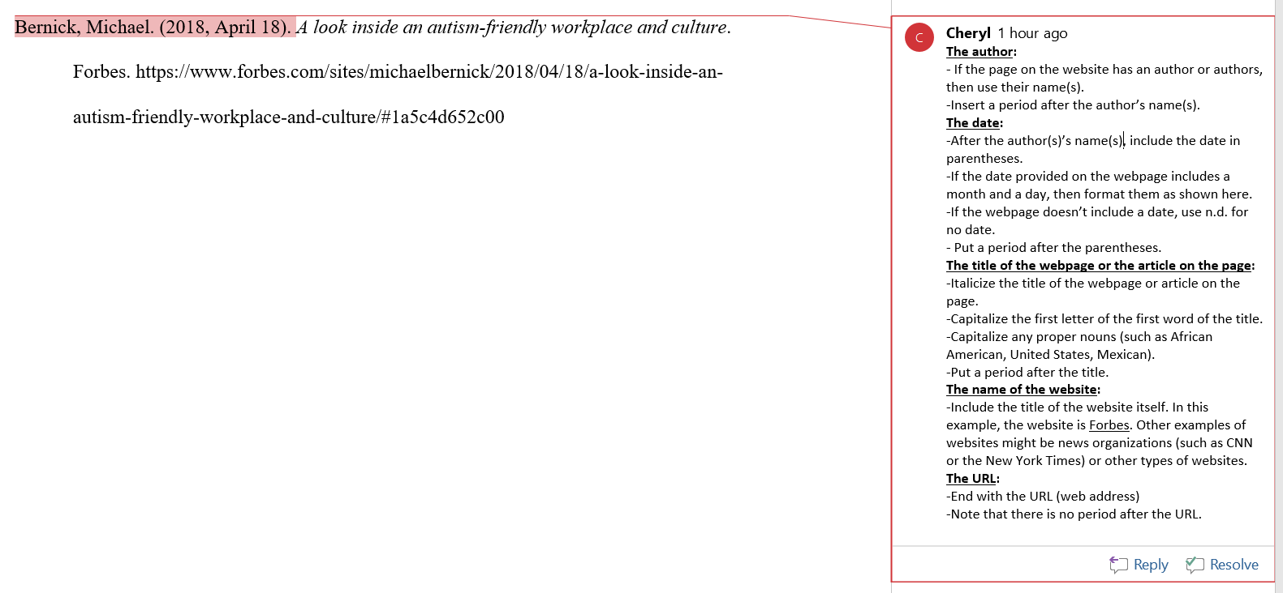
Example of the format for a webpage with an individual author

Slide 65
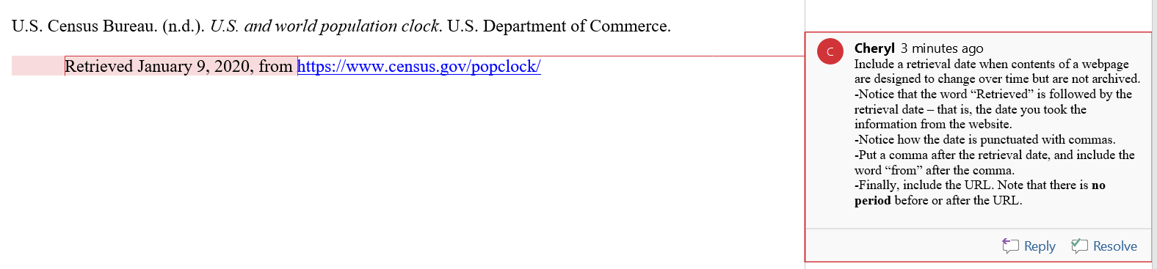
Example of the format for a webpage that requires a retrieval date
Use the words “Retrieved from” only when the contents of a webpage are designed to change over time but are not archived. Also include a retrieval date. Use the formatting rules provided in the comments in the example below.
In this example, the data is taken from the United States Census Bureau. The Bureau tracks population numbers, and so that data is designed to change over time.

Slide 66
How to format the entry for a government report
The author for this source is the United States Department of Justice (see slide 31 for a discussion of groups as authors). Put that government agency name in the author position. The inserted comments provide further instructions.

Slide 67
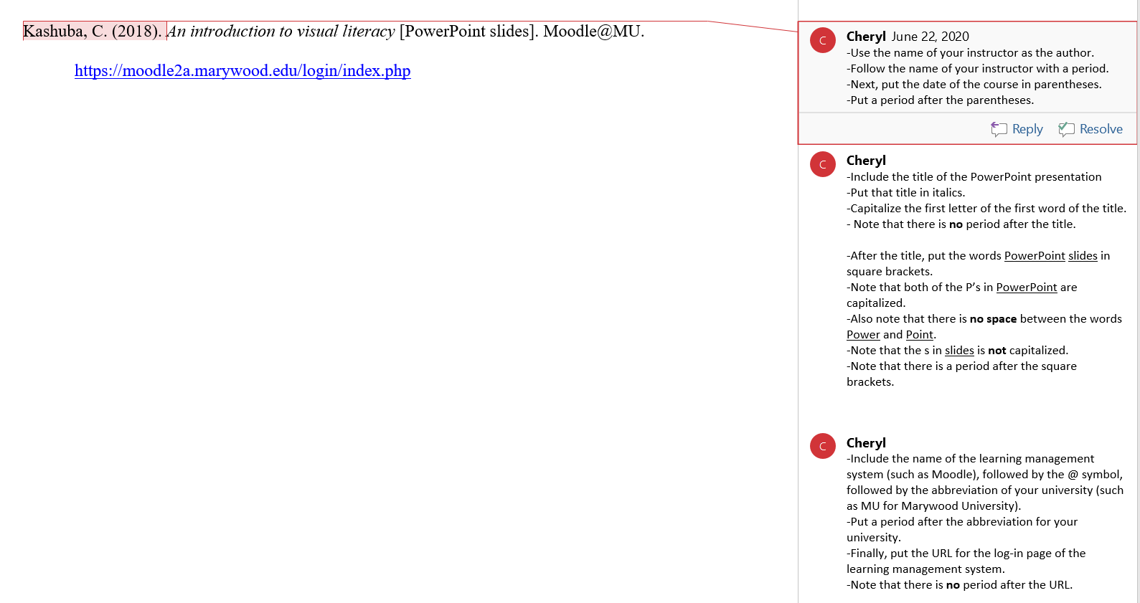
How to format the entry for PowerPoint slides from a course

